Slide 1
index.html
id; title; excerpt; description; latitude; longitude; city; country; number-likes; number-comments
Individual travel image page
logo
menu
large image
id-large.jpg
Description, city, country, # likes, # comments
Related
Image 1
Related
Image 2
Related
Image 3
Related
Image 4
id-small.jpg
title; excerpt; number-likes; number-comments
footer

Slide 2
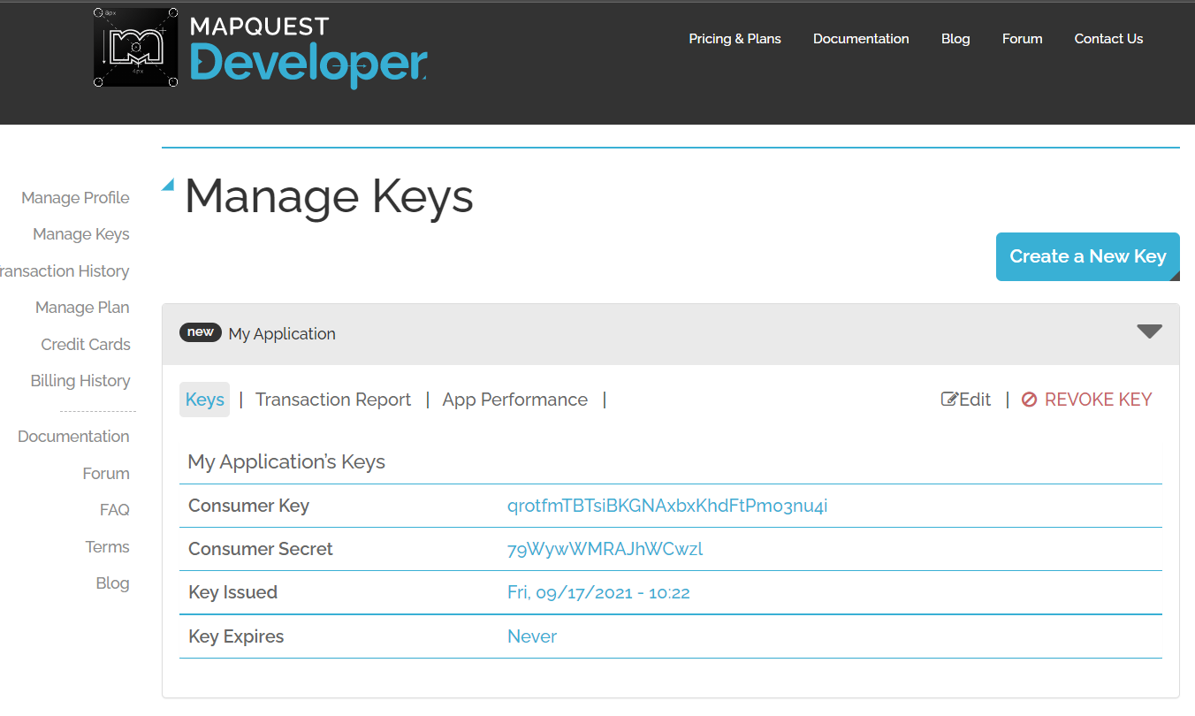
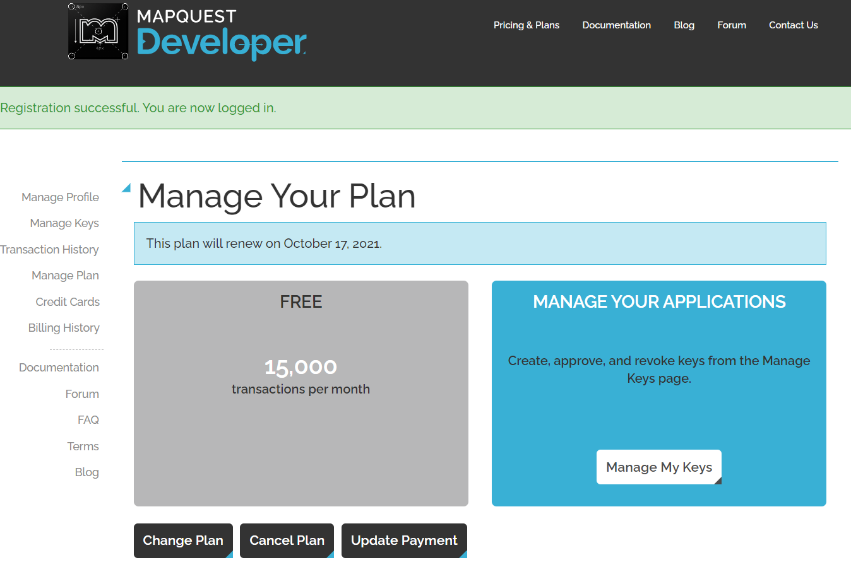

Slide 3
Example Static Image URL
https://www.mapquestapi.com/staticmap/v5/map?key=[your key]&center=51.061249,-114.158077&size=500,500&locations=51.061249,-114.158077
<img src="[static map url]" alt="map" />
latitude, longitude
width, height

